Slide 1
叙事中的时间、空间及其他
上海外国语大学 乔国强

Slide 2
Structuralism & narratology
Linguistics: Saussure’s signifier and signified;
Three major features of structuralism:
wholeness (totality, ensemble)
transformation
self-regulation
group, parent structure, network,
Narratology: elements and structures
formal studies

Slide 3
Existence and possible world
If we take “exists” as a quantifier, the domain of this quantifier is too narrow to accommodate the full extension of the predicate.
“exists”=actual
“Exists” is possible.
“is possible ” functions not as a predicate, to be applied within the domain of existing things, but as a quantifier whose domain subsumes the domain of existing things.
Fictional text: implies the that text is prior to the world, that it calls the world into existence and determines its structure.
Cognitive text: represents (image) a world that exists prior to, and independently of, textual activity. Because knowledge acquisition is an activity that requires us to make a distinction between true and false statements, it operates with constatives, with sentences and texts subject to truth-valuation.
Conclusion: （1）the domains of narratological studies are actually two: existence and possible；（2）overlap of the two.

Slide 4
Various conceptions of time
时间是小说的一个主要组成部分。我认为时间同故事和人物具有同等重要的价值。凡是我所能想到的真正懂得、或者本能地懂得小说技巧的作家，很少有人不对时间因素加以戏剧性地利用的。
——伊丽莎白·鲍温：《小说技巧》

Slide 5
“然后我看见了那个交叉小径的花园……作为一名作家，我的绝望就肇始于此……映入我眼帘的，均是同存性的事物，可现在流于我笔端的， 却是依次性的，因为语言是依次连接的。但不论怎样，我试图尽我所能追忆自己的所见。” J· L· 博尔赫斯 [阿根廷]：《交叉小径的花园》(Jorge Luis Borges, A Garden of Forking Paths)
“从某种意义上说，叙事的时间是一种线性时间，而故事发生的时间则是立体的。在故事中，几个事件可以同时发生，但是话语则必须把它们一件一件地叙述出来；一个复杂的形象就被投射到一条直线上。”茨维坦·托多罗夫：《作为话语的叙事》

Slide 6
Time in narrative
When it comes to a relationship between temporality and narrative three major perspectives need to be distinguished: (a) the general, philosophical aspect of temporality and its significance for the story and discourse level; (b) the relationship between the story and discourse levels; and (c) the grammatical and morphological devices (tense markers) and their significance for the discourse and story level.
Perspective (a) is a largely philosophical question that has been discussed in reference to Saint Augustine through Bergson to Paul Ricoeur; perspective (c) represents a linguistic and stylistic inquiry. Perspective (b) and (c) have traditionally had a significant status in narratology.

Slide 7
Story and discourse
Discourse time is measured in words or pages of text or in the hours of reading time, whereas story time represents the temporal duration and chronology of the underlying plot. The distinction becomes useful when one contrasts the uniform progression of story time, which is modelled on our everyday notions of clock and calendar time, with the fits and starts, pauses and speed-ups encountered on the discourse level of narratives. Thus many traditional novels end with a chapter that summarizes the hero’s life after the conclusion of the main events of the story, treating twenty years in three pages, whereas in previous sections a single day was awarded several chapters and some 100 pages of text. The relationship between story and discourse time therefore ties in with the general selectivity of narrative discourse.

Slide 8
Time in narrative (a)
Literature –like music—is a temporal art; for time is the
medium of narration, as it is the medium of life. (p. 3)
Time in literature always refers to elements of time as given in
experience. (p. 4)
What happens, happens now, that is, it is always an experience,
idea, or thing which is “present.”
they deal either with time in experience or with time in nature.
(p. 9)
Hans Meyerhoff, Time in Literature, 1974

Slide 9
Hans Meyerhoff proposed six aspects of time characteristic of literature:
Subjective relativity, or unequal distribution;
continuous flow, or duration;
dynamic fusion, or interpenetration, of the causal order in experience and memory;
duration and the temporal structure of memory in relation to self-identity;
eternity;
transitoriness, or the temporal direction toward death.
Hans Meyerhoff, Time in Literature (p. 85)

Slide 10
The fourth dimensions: the experiential properties of time.
Eternity: radical social movements undermine the eternity
believed and maintained by religion.
The temporal continuum into distinct, measurable units.
Social meaning of time: referring to the meaning which
time acquired in the process of production and
consumption in the modern world.
Are they the same: the time as the units of physical time
and the units of sensory experience?
The breakdown of time and experience into simple and
separate entities

Slide 11
历史决定论
1、“中立型”：一种取用过去的事实来追溯目前诸种事件的先例的研究方法；
2、“慎重型”：强调不断变化的诸种历史条件和语境是阐释一切具体事件的优先根据；
3、“敌对型”：攻击建立关于历史必然的诸种观念或历史嬗变一般法则基础之上的一切阐释和预见。
雷蒙斯·威廉斯：《关键词》
利科
的时间观
时间变成人性（human) 的时间，取决于时间通过叙述形式表达的程度，而叙述形式变成时间经验时，才取得全部意义。

Slide 12
叙述中的时间都是把自然时间人文化的过程。这样的时间都蕴含着人类的某种独具特质的情愫，如欢乐、哀愁、悲伤、幸福、寂寞、胜利、沮丧、期盼、失望等。
the measure of time;
the structure of time;
absolute and relative time;
sacred and secular time;
past, present and future time;
time of a particular moment;
earlier and later time;
the end and beginning of time;
concept of future;
concept of eternity;
concept of the past;
concept of time flow;
glorious past and prophetic future;
concept of linear time;
concept of circular time;
etc.
Possible time

Slide 13
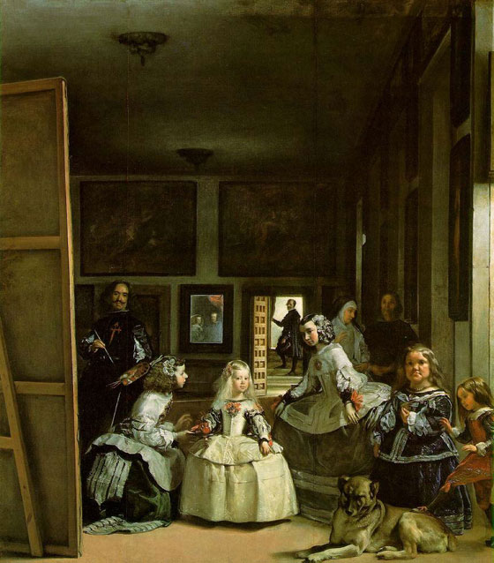
一般符号文本的时间向度是自由的，而叙述文本的时间向度的限制一直是叙述文本作为一种体裁性边界的重要尺度。

Slide 14
Genette’s temporality of narrative
Order: the set of relations between the order in which events (are said to) occur and the order in which they recounted.
Duration: the set of phenomena pertaining to the relation between story time and discourse time. The former can be greater than the latter, equal to it, or smaller than it.
time
Frequency: the relationship between the number of times an event happens and the number of times it is recounted.

Slide 15
Temporal relations
The events recounted in a narrative are organized along a temporal axis. Some may be simultaneous:
At eight o’clock, John got up and the birds were singing.
But as least one must precede another one at a time. Should an event A precede an event B in time, the two may be temporally adjacent, or proximate, or distant:
As soon as he arrived, he started to cry.
Furthermore, the duration of two non-synchronous events may or may not be equivalent:
Joan ran for an hour, then she ate for an hour.
Note that, in some narratives, it may happen that certain events cannot be dated with any degree of precision and cannot be situated temporally in relation to other events.

Slide 16
Sequence: a component unit of narrative that is itself capable of functioning as a narrative; a series of situation and events of which the last one in time constitutes a partial repetition or transform of the first one. In“Jane was happy, and Susan was unhappy; then Jane met Peter, and she became unhappy,” “Susan was unhappy; then Susan met Flora, and she became happy” constitutes a sequence and so does “Jane was happy; then Jane met Peter, and she became unhappy.” The combination of sequences through linking, embedding, and alternation yields ever more complex stories.

Slide 17
“The king died, the queen died soon.”
“The king died and the queen died of heartbreak.”
Possibilities:
The importance of the king for the queen; they loved each other too much;
A conspiracy in the court, the king was murdered, the queen got to know it was her family member killed her husband;
The king died, and the queen was ordered to kill herself for her husband—a feminist reading.
…

Slide 18
paralepsis （多叙）： narration that reflects a greater knowledge than the narrator could presumably have; in other words, narration in which the narrator tells more than he or she knows.
paralipsis （少叙） ： narration that does not reflect the narrator’s full relevant knowledge; in other words, narration in which the narrator tells less than he or she knows.
anachrony （时间误置）
analepsis （倒叙）
Prolepses（预叙）
Paralepsis（多叙）
Paralipsis （少叙）
写作时间和阅读时间
叙事时间还包括“连贯、交替和插入”，连贯是并列几个不同的故事，上一个故事结束，又开始下一个故事；插入是把一个故事插入到另一个故事里去，形成故事套故事的结构；交替是同时且交替地叙述两个故事。

Slide 19
Space in narrative
Two reasons for the slow appearance
In narrative theory, consideration of space got off to a slow start mainly for two reasons. One was that Gotthold Ephraim Lessing’s characterization of narrative literature as a “temporal” art (as opposed to “spatial” arts like painting and sculpture) seemed too evident to be seriously interrogated. The second reason was that space in narratives—especially pre-nineteenth-century ones—often seemed to have no other function than to supply a general background setting, something to be taken for granted rather than requiring attention, far less essential than the temporal directedness of the plot.

Slide 20
A brief survey of the development
There is a “spatial turn” in narrative theory whose pre-history can be traced along four major way stations.
Disregarding Lessing’s dictum, many descriptions of narrative style, organization, and structure, notably those articulated by Henry James at the beginning of the twentieth century, employ the images of spatial arts, esp. painting and architecture;
In a much-noted essay Joseph Frank discussed “Major works of modern literature”—by Flaubert, Proust, and Joyce—whose practice of juxtaposing simultaneous events created what he termed a spatial form;
In a pathbreaking essay on chronotopes (literally, “timespace”)
In the 1940s and 50s, the French philosophers Maurice Merleau-Ponty and Gaston Bachelard offered a liberating theorization of “lived space”, a concept specifically addressing space within the framework of literature and human perception.

Slide 21
Defining narrative space
At its most basic level, narrative space is the environment in which story-internal characters move about and live. Narrative space is characterized by a complex of parameters:
by the boundaries that separate it from coordinate, superordinate, and subordinate spaces;
by the objects which it contains;
by the living conditions which it provides,
by the temporal dimension to which it is bound.
Narrative space in this sense includes landscapes as well as friendly or inimical conditions (including climatic and atmospheric ones), and it is never simply “the north of England”, but “the north of England at the beginning of the 19-century.

Slide 22
“Framed” and “framing” spaces
Ruth Ronen (“Space in Fiction” Poetics Today, 1986, 7.3 421-38) proposed a distinction between “framed” and “framing” spaces and her technical definition of “setting” as the current base-level spatial frame, equivalent to the space represented on a theatrical space (“the actual immediate surrounding of an object, a character or an event”). If the base-level setting is room, for instance, it is usually conceived of as being part of a set of framing spaces—a house, a city, a country, a continent, etc. Many systematic distinctions can be derived on the basis of these stipulations—zones of decreasing/increasing sharpness, foreground and background spaces, open and closed spaces, accessible and inaccessible spaces, close and distant spaces, actual and imaginary spaces, static and dynamic spaces, etc.

Slide 23
Three types of spatial organization
Three types of spatial organization within narrative worlds might be distinguished:
texts containing contiguous sub-spaces, where characters freely move from one space to the next;
texts with dis-continuous, ontologically distinct spaces that allow communication in exceptional circumstances only (Lewis Carroll’s Alice in Wonderland);
texts with ontologically distinct spaces that do not allow communication, except through metalepsis (进一步转喻法指把已作比喻用的词进一步用于另一比喻意义的一种修辞法）(e.g. texts with embedded fictions).

Slide 24
空间研究的三个核心与三个层面
米克·巴尔的“在其内”与“在其外”
列斐伏尔“三维度”：空间实践、空间表征、
表征的空间
福柯的空间与权力
语篇层面：以语篇为对象的研究
事件/情节层面：以事件/情节为对象的研究
意义层面：以空间寓意为对象的研究
空间的破碎性与生成性

Slide 25
叙事空间
（米克·巴尔：《叙事学》第2版，第156-167页）
空间方面与感知：在故事中，空间是与“生活”在其中的人物联系在一起的，空间的首要方面就在于人物所产生的意识在空间中表现的方式。空间感知中特别包括三种感觉：视觉、听觉和触觉……借助这三种官能感觉，可以指明人物与空间之间的两类关系。人物位于其中的空间，或正好不位于其中的空间，可被看作为一个结构。空间得以充实的方式也可被指出。（157-58）

Slide 26
内容与功能
空间方面的语义内容可以像人物的语义内容那样建立起来。这里，我们也发现确定、重复、积聚和转变的初步结合，以及不同空间之间的相互关系。
在读者参照系的基础上，确定再次得以完成……“在厨房里”、“在起居间”等符号将唤起更多的精确形象。
对一个空间的描述越精确，在一般性中所增加的独特性就越多，一般性也因此而变得较不显眼。但是，一般的特征从未停止其作用。只有通过一般特征才有可能产生一种完整的形象。
空间在故事中以两种方式起作用：只是一个结构，一个行动的地点；完全留在背景中……空间可以静态地（如睡觉）或动态的（如开车）起作用。（160-62）

Slide 27
Heterotopia（异托邦）
福柯：《其他空间》
城市异托邦就其叙述者而言，可分为两种形态：其一，叙述者亲身体验了城市异托邦文化空间，尔后通过创作来表现，这是其核心形态；其二，叙述者没有亲身体验城市异托邦的文化空间，而是完全借助其他媒介（文字、影像、传言等）进行创作，从逻辑角度而言，其隶属于第一形态。城市异托邦作为想象的地理，是空间、知识、权力三位一体的集合体；叙述者在描写他者文化中的城市形象时，一般要经历凝视、想象、记忆、叙述等阶段；对于叙述者而言，是一种空间体验，对于城市异托邦而言则是一种文化表征。

Slide 28
城市异托邦的两幅面孔
在不同的文化体系之间，城市作为异托邦，其具体形象可能千变万化，但依据逻辑上的二分法，最基本的面孔只能有两幅：其一，该城市文化与叙述者的文化以相异性为主；其二，该城市文化杂糅了叙述者的文化，体现出更多的相似性。
城市空间（街道、核心区、标志性建筑景观）
城市人的族群性
叙述者的态度

Slide 29
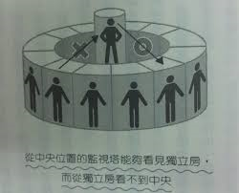
福柯：边沁的全景敞视建筑（panopticon）……其构造的基本原理是……：四周是一个环形建筑，中心是一座瞭望塔。瞭望塔有一圈大窗户，对着环形建筑。环形建筑被分成许多小囚室，每个囚室都贯穿建筑物的横切面。各囚室都有两个窗户，一个对着里面，与塔的窗户相对，另一个对着外面，能使光亮从囚室的一端照到另一端。然后，所需要做的就是在中心瞭望塔安排一名监督者，在每个囚室里关进一个疯人或一个病人，一个罪犯、一个工人、一个学生。通过逆光效果，人们可以从瞭望塔的与
光源恰好相反的角度，观察四周囚室里被囚禁者的小人影。这些囚室就像是许多小笼子、小舞台。在里面，每个演员都是茕茕孑立，各具特色并历历在目。敞视建筑机制在安排空间单位时，使之可以被随时观看和一眼辨认。总之，它推翻了牢狱的原则，……推翻了它的三个功能——封闭、剥夺光线和隐藏。它只保留了下第一个功能，消除了另外两个功能。充分的光线和监督者的注视比黑暗更能有效地捕捉囚禁者。……可见性就是一个捕捉器。福柯：《规训与惩罚》，第224页。
全景敞视建筑

Slide 30
Lefebvre develops what he calls a “conceptual triad”—Edward Soja would later term it a “trialectics of spaciality”—to address the different vortexes of his analysis: spatial practices, representations of space, and representational spaces. The first appears as a collective embodiment of an abstract realm of space; it comprises “the particular locations and spatial sets characteristic of each social formation.” The second, representations of space, offers the langue, “the signs, codes, and ‘frontal’ relations” that underlie that very formation. Representational spaces appear as the individual parole, for they refer to “the clandestine or underground side of social life” (1991, 33) Before Lefebvre, E. Cassirer has established a similar tripartite division in An Essay on Man: organic, perceptual and symbolic spaces.

Slide 31
列斐伏尔在《空间的生产》一书中，对空间做了三个层面的区分。第一个部分是纯粹的空间演练 （spatial practice空间实践），即现实生活的空间或者小说文本的幻想空间中人物和场景的一个表现或者说呈现。这是第一层次的空间。第二部分是空间的再现（representations of space空间表征），它的英文翻译和法文原文其实有一点区别。它的意思是人在经由空间演练过程之中经历到的空间中所覆盖的或者本身具有的一些结构关系，比如说限制、法规或者说限制性的城市规划等。第三部分是所谓的再现的空间（representational space表征的空间），也就是说，我意识到了我所在的空间的历史积淀，包括的它的历史痕迹和传统（这是第一层次的空间）和法规、具体规划（这是第二层次的空间）的存在，经由我作为“人”的行动力和空间中的活动，去将前面两层空间展演出来。这就是列斐伏尔所认为的三个不同层次的空间之间的关系。
Conceptualized space
The space we live in.

Slide 32
Bakhtin’s chronotope
“We will give the name of chronotope (literally, ‘time space’) to the intrinsic connectedness of temporal and spatial relationships that are artistically expressed in literature. This term [space-time] is employed in mathematics, and was introduced as part of Einstein’s Theory of Relativity. The special meaning it has in relativity theory is not important; for our purposes we are borrowing it for literary criticism almost as a metaphor (almost but not entirely). What counts for us is the fact that it expresses the inseparability of space and time (time as the fourth dimension of space). We understand the chronotope as a formally constitutive category of literature; we will not deal with the chronotope in other areas of culture.
“In the literary artistic chronotope, spatial and temporal indicators are fused into one carefully thought-out, concrete whole. Time, as it were, thickens, takes on flesh, becomes artistically visible, likewise, space becomes charged and responsive to the movements of time, plot, and history. This intersection of axes and fusion of the indicators characterizes the artistic chronotope.”
—M . M. Bakhtin, "Forms of Time and of the Chronotope in the Novel: Notes toward a Historical Poetics" (Brian Richardson (ed.), Narrative Dynamics: Essays on Time, Plot, Closure, and Frames, Columbus: The Ohio State University Press, 2002), p. 15.

Slide 33
其他观点
空间是由人类活动生产出来的物质空间和隐喻空。
场地（topos）：一些著名的定型组合，空间与事件之间的关系会变得一清二楚，如月光下阳台上的爱情；高山之巅好高骛远的幻想；小旅馆内的幽会；废墟中幽灵的出现；咖啡馆里的吵闹……它们有时成为一个作家、有时成为一种运动、有时甚至成为一部小说的特色（如“床”）。当然，期待一个清楚地标示的空间起一个适当事件的结构作用，也可能会落空。
人物所处的空间位置在一定时候常常影响到他们的情绪。
时间与空间之间的关系对于叙述节奏是很重要的。当空间被广泛描述时，时间次序的中断就不可避免，除非对于空间的感知逐渐地发生（及时地），并因此而能被看作事件。

Slide 34
Time & space
叙事结构具有空间句法的状态
space
1
2
time
0
1) He entered the room and put down the bag.
2) As soon as he closed the door, he put down the bag.

Slide 35
Impossibility of ethnic assimilation
Jacob cannot be assimilated
assimilation
Sara cannot be assimilated
Jacob + Wanda
Jacob + Sara
Gentile community
sequences
Jewish community
Time and space in The Slave

Slide 36
The spatiotemporal circumstances in which the events of a narrative occur. Setting may be textual prominent or negligible, consistent (when its features are not contradictory or inconsistent, vague or precise, presented objectively or subjectively, presented in orderly fashion (the façade of a house is described from left to right…) or in a disorderly one, and so on.
setting
红酥手，黄縢酒，满城春色宫墙柳。东风恶，欢情薄。一怀愁绪，几年离索。错、错、错。 春如旧，人空瘦，泪痕红浥鲛绡透。桃花落，闲池阁。山盟虽在，锦书难托。莫、莫、莫！

Slide 37
写景与叙事的关系
1、以景引事；
2、以景比事；
3、以景代事；
4、亦景亦事
5、景即为事；
6、用事写景；
7、事在景外。
无论是融人物行动的景色描写，还是单纯的写景，几乎都可以看作叙事的一部分甚至就是叙事本身。

Slide 38
以景引事
青青陵上柏，磊磊涧中石。 人生天地间，忽如远行客。 斗酒相娱乐，聊厚不为薄。 驱车策驽马，游戏宛与洛。 洛中何郁郁，冠带自相索。 长衢罗夹巷，王侯多第宅。 两宫遥相望，双阙百余尺。 极宴娱心意，戚戚何所迫？
类似于“兴”的手法运用，有的只是引起话题、烘托气氛；有的则暗含比拟的意味，即“兴”和“兴而比”的区别。
作者：佚名

Slide 39
以景比事
王逸说：“《离骚》之文，以诗取兴，引类譬喻。故善鸟香草，以配忠贞；恶禽臭物，以比谗佞；灵修美人，以媲于君；宓妃佚女，以譬贤臣；虬龙鸾凤，以托君子；飘风云霓，以为小人。”（武汉大学中文系中国古代文学理论教研室编：《历代诗话词话选》武汉大学出版社，1984年，第120页）

Slide 40
以景代事
以写景的方式交代故事的过程或结局，叙事意图比较强烈。
月黑雁飞高，
单于夜遁逃。
欲将轻骑逐，
大雪满弓刀。
首句可视为渲染气氛交代环境的“兴”诗由写景开始，“月黑雁飞高”并非眼中之景，而是意中之景；中二句为叙事，而末句尽管可能只是轻骑将发时的景物描写，但却暗示时态发展结局或过程。

Slide 41
亦事亦景
从读者的角度来看，亦事亦景是把事作景看；从作者的角度来看，就是叙事作景。
叙述一女子长夜相思的举动，最后两句构建一副凝定的唯美画面。
玉阶生白露，
夜久侵罗袜。 却下水晶帘，
玲珑望秋月。
李白

Slide 42
景即是事
与以景代事相近，既可视之写景，亦可看做叙事。作者的主观意图在于写景而非记事，然写景中蕴含着事。
太乙近天都，
连山接海隅。
白云回望合，
青霭入看无。 分野中峰变，
阴晴众壑殊。
欲投人处宿，
隔水问樵夫。
王维：《终南山》
诗的前六句分别从不同角度叙写终南山风貌，暗含诗人的游历之过程，既可视之为写景，也看作是叙事。

Slide 43
这个“用事”不是指用典，而是指用叙事的方法写景，主观意图在写景，用的却是叙事的方式，但却与“亦景亦事”中“情景交融”不同。
用事写景
河决三门合四水，径流万里东输海。巩洛之山夹而峙，河来啮山作沙觜。山形迤逦若奔避，河益汹汹怒而詈。舟师弭楫不以帆，顷刻奔过不及视。舞波渊旋投沙渚，聚沫倏忽为平地。……
欧阳修：《巩县初见黄河》

Slide 44
事在景外
中国诗学素重“知人论世”，从叙述学的角度讲，或许可以理解为诗歌的创作者以其实际行动乃至整个人生形成作品之外的另一个叙事文本，与诗歌文本形成一种相互阐释的关系。
我家江水初发源，宦游直送江入海。
闻道潮头一丈高，天寒尚有沙痕在。
中泠南畔石盘陀，古来出没随涛波。
试登绝顶望乡国，江南江北青山多。
羁愁畏晚寻归楫，山僧苦留看落日。
微风万顷靴文细，断霞半空鱼尾赤。
是时江月初生魄，二更月落天深黑。
江心似有炬火明，飞焰照山栖乌惊。
怅然归卧心莫识，非鬼非人竟何物？
江山如此不归山，江神见怪惊我顽。
我谢江神岂得已，有田不归如江水。
北宋文学家苏轼此时因批评新法主动请求外任，昔日满腹壮志，此刻前途渺茫，仕途与诗结合，其意无出“我家”与“宦游”二语。

Slide 45
中国叙事文学的“空间转化”
与西方“时间化”经典叙事结构不同，中国古代叙事结构模式呈现出“空间化”特征。在这种叙事结构模式中，“时间性”因素退居次位，“空间性”因素占据结构中心位置。
在中国古代，“叙事”与“序事”可以互换使用。“序”的空间含义明显。清人张竹坡（1670-1698）说：“做文如盖造房屋，要使梁柱笋眼，都合得无一缝可见；而读书人的文字，却要如拆房屋，使某梁某柱的笋皆一一散开在我眼中也。”（《张竹坡批评金瓶梅》，齐鲁书社，1991年版第40页）

Slide 46
先秦两汉史传的“空间化”特征
共时性：与西方强调“首、身、尾”叙事线条的整一连贯、具有时序性和因果律的“时间化”结构模式不同，中国古代叙事的“空间化”叙事结构主要是一系列时间的罗列与连缀，因而呈现出“缀段式”（episodic）叙事；
“空间化”叙事结构中，“事件”所处位置具有结构性功能与意义，是中国古代整体性思维方式在叙事结构思想上的折射，即在整体关联中关照事物，在相互关联中确定其关系、功能和地位。事件借助所处位置获得结构性功能和价值；
“空间化”叙事结构之“结构之枝”与“结构之道”（杨义语），以“结构之形”传达“结构之神”。
（参见熊江梅：《先秦两汉叙事思想》）

Slide 47
中国古代叙事的“时空观”
中国古代叙事普遍表现出轻“再现”重“表现”的“亚叙事”倾向，并形成了中国古代叙事思想独特的“诗化”特征。
在史传叙事结构上，显示出由“编年体”向“纪传体”转换的趋势，淡化“历时性”事件流程，强化“共时性”场景呈现，逐渐发展出“空间化”叙事结构思想，在淡化时序和因果律的同时，却通过对事件系列的精心排列与连缀，产生某种“有意味”的组接，借以传达某种认知与情感。

Slide 48
传统叙事的“空间化”
以叙事结构而论，叙事以“历时性”为构架特征，抒情以“共时性”为构架特征，但中国古代叙事诗叙事结构却普遍呈现出“空间化”取代“时间化”的构架特征，于是，叙事向感事转化，表现出一种“亚叙事”的“诗化”倾向。这些叙事诗并不构成“论述始终”的叙述，而是强调借助场景、画面的并置与连缀传达某种情致，是一种侧重于“感事”的“亚叙事”，从而表现出叙事思想上的“诗化”特征。

Slide 49
中国古典小说中的时空关系
中国古典小说，包括“新小说”“习惯于采用连贯叙述，有的好像商家记‘四柱帐’，笔笔从头到尾，一丝不漏（沈雁冰：《自然主义与中国现代小说》），如彭养鸥的《黑籍冤魂》记吴家五代人受鸦片之苦，一代代叙来毫无变化。有的好像旅人坐火车看风景，‘第觉眼前景物排山倒海向后推去耳，’（阿英编《晚清文学丛钞·小说戏曲研究卷》之《小说管窥录·宪之魂》）景与景之间可以没有统一的时间尺度，可每一景的叙事时间却是连贯的，如李伯元的《官场现形记》……有的作家意识到传统小说叙事时间的缺陷，想用‘蟠曲回旋’来取代‘随便起止’（曾朴：《修改后要说的几句话》）；用‘倒戟而入’来取代‘话分两头’（诞叟[钱锡宝]：《梼杌萃编》）。陈平原：《中国小说叙事模式的转变》

Slide 50
“五四”作家的真正贡献在于，倒装叙述不再着眼于故事，而是着眼于情绪。过去的故事之所以进入现在的故事，不在于故事自身的因果联系，而在于人物的情绪与作家所要创造的氛围——借助于过去的故事与现在的故事之间的张力获得某种特殊的美学效果。（陈平原：《中国小说叙事模式的转变》）

Slide 51
“游子回乡”母题：（1）沉醉在童年与故乡的回忆中；（2）因憎恶周围环境而无意中虚构了一个作为精神寄托的故乡；（3）对于被放逐这来说，故乡不属于他们，有家难回，乡思转化为乡愁。
作用：它形成了一个参照系，衬出并量出今日故乡的衰微与游子的感伤。或渲染作家独特的主观情绪，或宣传作家所从属的政党社团统一的政治思想。

Slide 52
联想
很可能是凌空跳跃，转瞬即逝的“不规则”联想。
休谟的联想三原则：相似性、连接性、因果性；
哈特莱：“接近律”。
同一情景引起的联想因人而异；即使都联想到某一共同经历的事件，也会有不同的侧重点，每个人都是自觉不自觉地强调了某一部分而遗忘了另一部分。倘若真实地记录人物在某一时间的思绪，很可能并非一个完整的事件，而是某一个事件的片断——残留在脑海里而又刚被唤醒的印象。这些印象并非按发生的自然时序依次浮现，而是因其联想的关系密切，或者是原始的感觉生动、重现的次数多、距离时间近等原因而优先浮现。
“联想很可以拿蔓草来比喻：蔓草托根在这里，能够爬过破墙，纠结着邻园灌木的干本，末端却伏在树下的乱草里；你要去寻找他的根本何在，或是怎样蔓延开来的，是一件极难的事。人心一时联想起的种种也就是这个样子，从‘蜻蜓’竟蔓延到‘我的胡子’。”叶圣陶：《恐怖的夜》

Slide 53
“凡作诗不宜逼真，如朝行远望，青山佳色，隐然可爱，其烟霞变幻，难以名状。……远近所见不同，妙在含糊，方见作手。” 谢榛：《四溟诗话》，见陈良运主编《中国历代诗学论著选》，南昌：百花洲文艺出版社1995年版，第683页。
羽书昨夜过渠黎，单于已在金山西。戍楼西望烟尘黑，汉兵屯在轮台北。上将拥旄西出征，平明吹笛大军行。
——岑参：《轮台歌奉送封大夫出师西征》
如果不了解该诗的写作背景，便会有莫名其妙之感。因为诗歌中的“渠黎”是汉代西域国名；“单于”是西汉匈奴最高首领的名字；“轮台”这个地名在唐代倒是有，问题是驻扎在此地的士兵又是一群“汉兵”。这就不免让人心中嘀咕：岑参咏歌的这场“上将拥旄西出征，平明吹笛大军行。”的战争，与其说是对发生于盛唐西北边塞战争的一种真实写照，不如说是对汉代上空的一场历史战役进行追溯来得更为适合。

Slide 54
Critical terms of narrative space
foregrounding
gapping
isotopy
center
liminality
margin
migration
transgression
transition
etc.

Slide 55
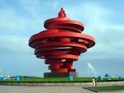
The city image and its elements
paths
edges
districts
nodes
landmarks
element interrelations
the shifting images
image quality

Slide 56
designing the paths
design of other elements
form qualities
the sense of the whole
metropolitan form
the process of design
City form

Slide 57
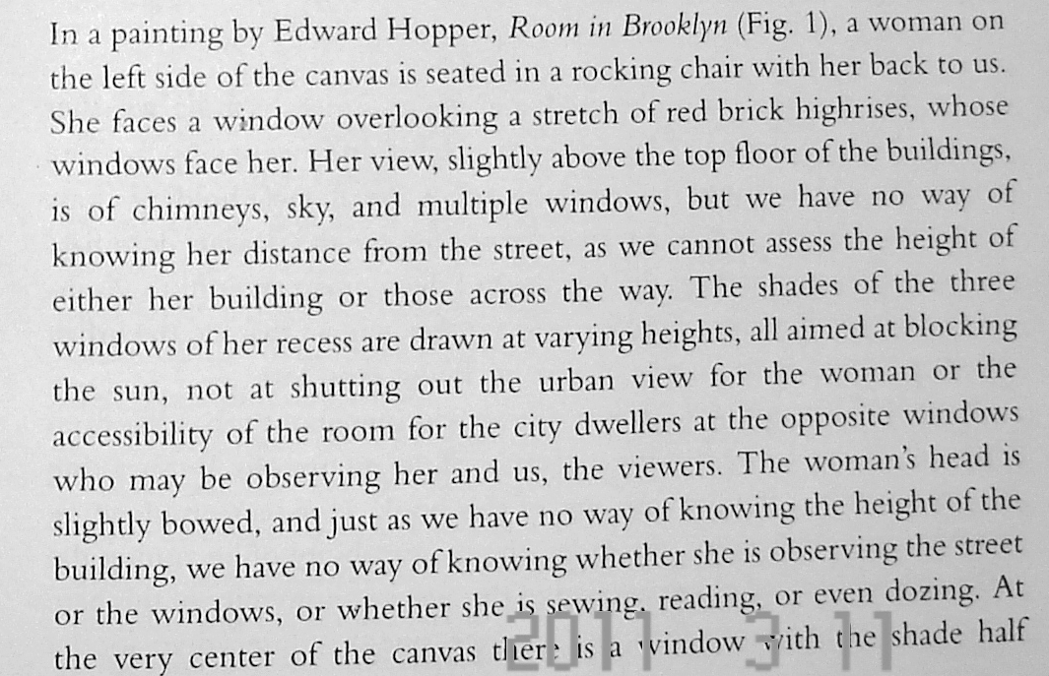
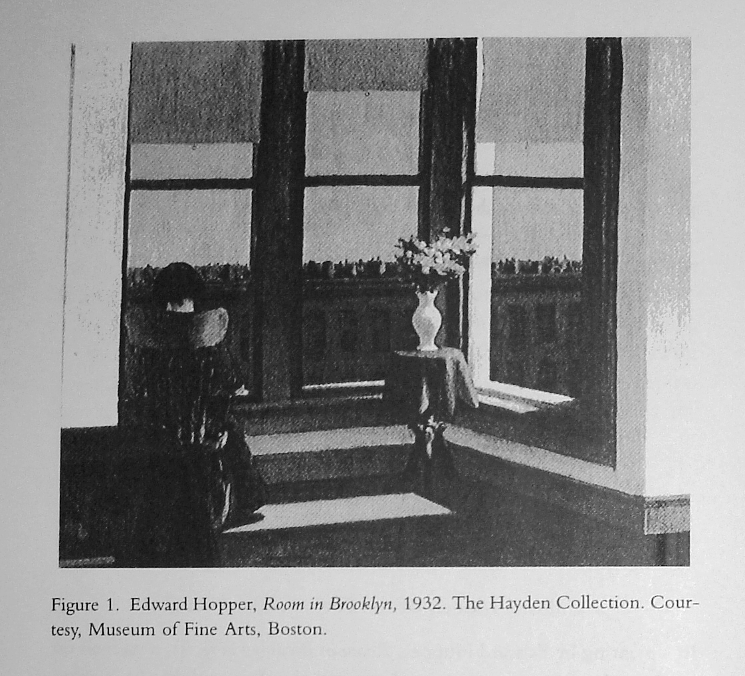
Cultural models of the city -- Whose city?

Slide 58
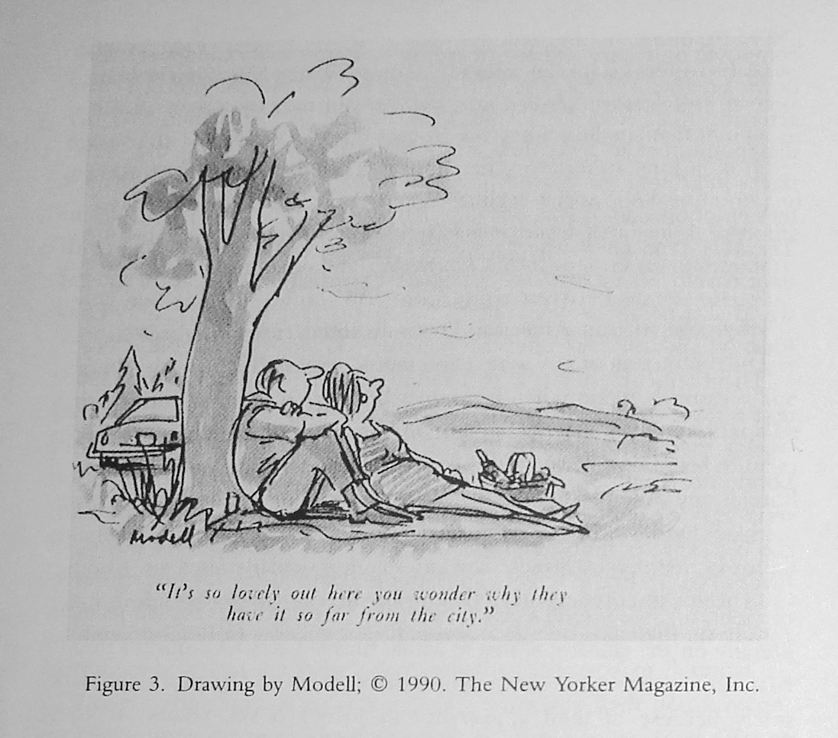

Slide 59
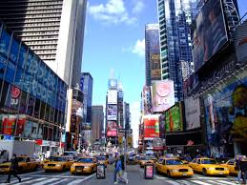
Possible space: a city
the city as a text, and the text as a city.
institutionalized
disciplined
whose city?
the politics of the street
community
down town
cultural centre
transportation
architecture
(mass) media
social norms
factories, pollution, ads., schools, universities, etc.

Slide 60
Topics for discussion
the spatialization of power and feeling
partitioned cities: spiritual and temporal walls
divided cities: social walls
translated cities: domesticating the foreign
estranged cities: de-familiarizing home
cultural confrontation in urban America
a double life: the fate of the urban ethnic
the city and I
living with change
the city as battleground
the child’s/woman’s/girl’s/farmer’s perception of the city

